Slide 1

GIT Basics

Slide 2
Agenda
Setting up a Git Client
Working with GIT - Git Init,
Head/Master/Feature Branches,
Pull Request,
Check in/Check-out/Merge

Slide 3
What is Git?
Git is an open-source distributed version control system.
It is designed to handle minor to major projects with high speed and efficiency.
It is developed to co-ordinate the work among the developers.
The version control allows us to track and work together with our team members at the same workspace.

Slide 4
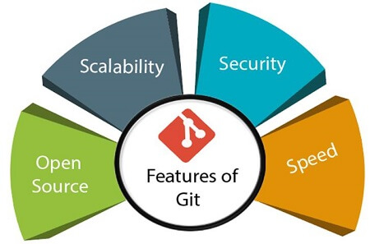
Features of Git

Slide 5
Branching and Merging
Branching and merging are the great features of Git, which makes it different from the other SCM tools.
Git allows the creation of multiple branches without affecting each other.
We can perform tasks like creation, deletion, and merging on branches, and these tasks take a few seconds only.

Slide 6
Staging Area
The Staging area is also a unique functionality of Git.
It can be considered as a preview of our next commit, moreover, an intermediate area where commits can be formatted and reviewed before completion.
When you make a commit, Git takes changes that are in the staging area and make them as a new commit.
We are allowed to add and remove changes from the staging area.
The staging area can be considered as a place where Git stores the changes.

Slide 7
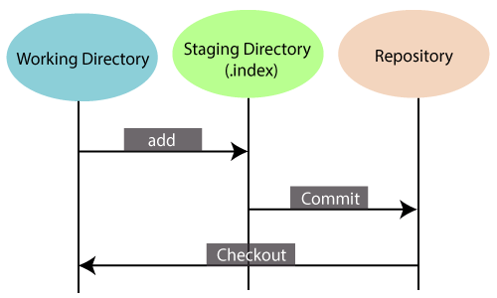

Slide 8
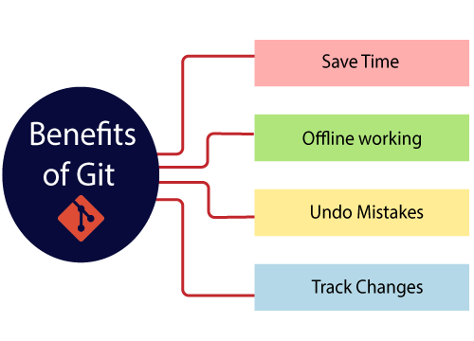

Slide 9
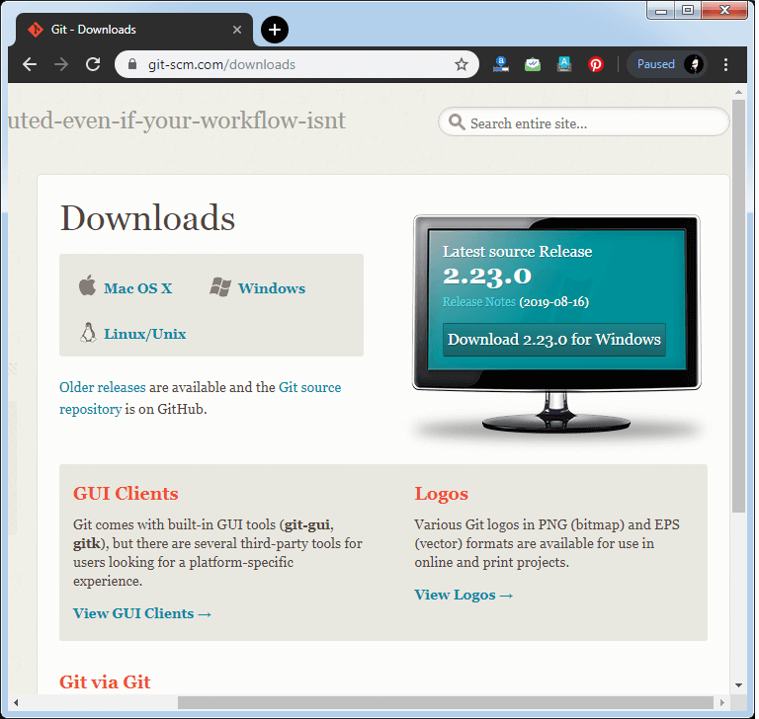
How to Install Git on Windows
Step1:To download the Git installer, visit the Git's official site and go to download page. The link for the download page is https://git-scm.com/downloads. The page looks like as

Slide 10
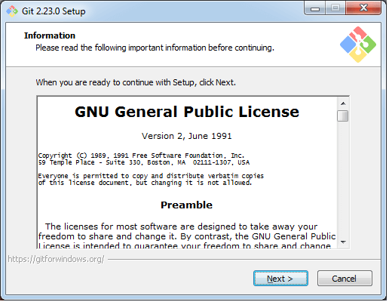
Install Git

Slide 11
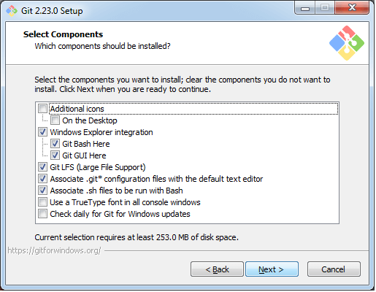

Slide 12
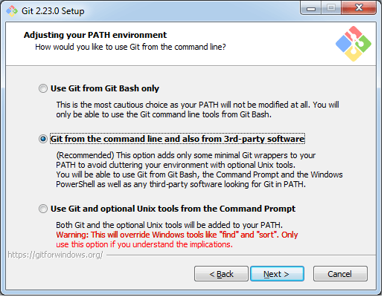

Slide 13
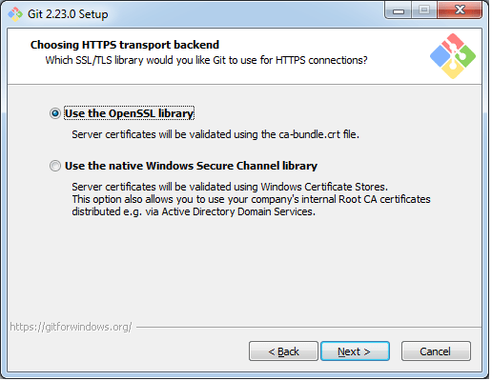

Slide 14
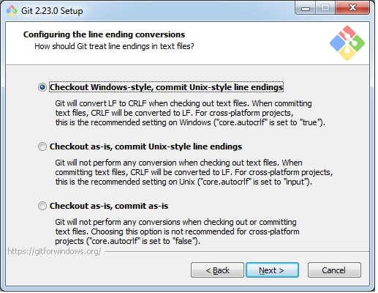

Slide 15
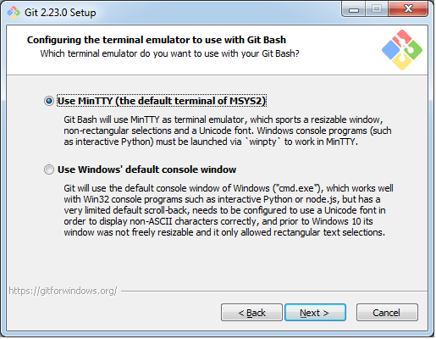

Slide 16
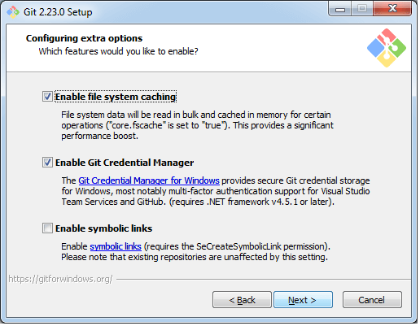

Slide 17
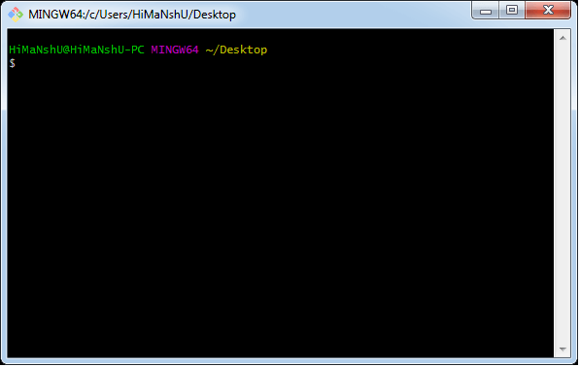

Slide 18
Git Init
The git init command is the first command that you will run on Git.
The git init command is used to create a new blank repository.
It is used to make an existing project as a Git project. Several Git commands run inside the repository, but init command can be run outside of the repository.
The git init command creates a .git subdirectory in the current working directory.
This newly created subdirectory contains all of the necessary metadata.
These metadata can be categorized into objects, refs, and temp files. It also initializes a HEAD pointer for the master branch of the repository.

Slide 19

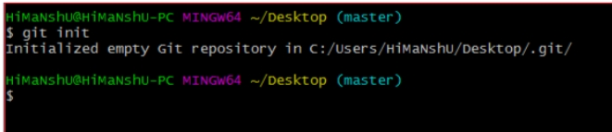
Create a Repository for a Blank (New) Project:
To create a blank repository, open command line on your desired directory and run the init command as follows:

Slide 20
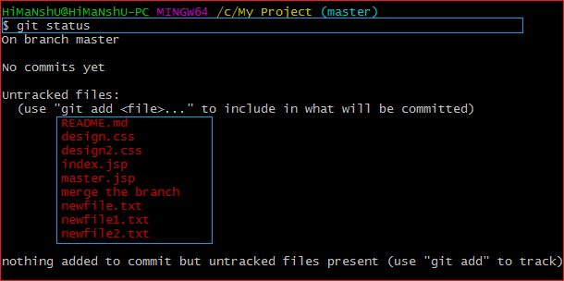
To create a file, run the cat or touch command as follows:
$ touch <file Name>
To add files to the repository, run the git add command as follows:
$ git add <file name>
We can list all the untracked files by git status command. $ git status

Slide 21

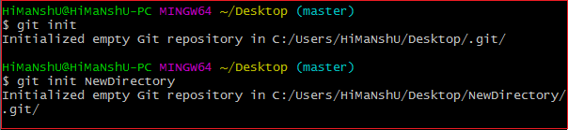
Create a Repository and Directory Together
The git init command allows us to create a new blank repository and a directory together. The empty repository .git is created under the directory.
Suppose I want to create a blank repository with a project name, then we can do so by the git init command. Consider the below command:

Slide 22

Git Head
The HEAD points out the last commit in the current checkout branch.
It is like a pointer to any reference. The HEAD can be understood as the "current branch."
When you switch branches with 'checkout,' the HEAD is transferred to the new branch.
The git show head is used to check the status of the Head. This command will show the location of the Head.

Slide 23
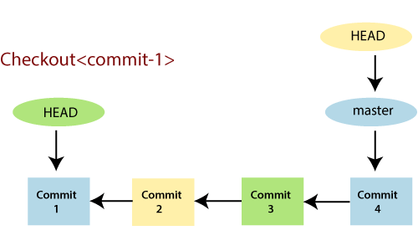

Slide 24
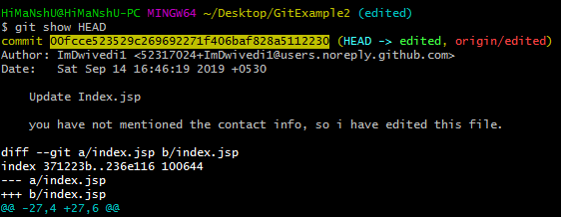

Slide 25
Git Origin Master
The term "git origin master" is used in the context of a remote repository. It is used to deal with the remote repository.
The term origin comes from where repository original situated and master stands for the main branch.
Master is a naming convention for Git branch. It's a default branch of Git.
After cloning a project from a remote server, the resulting local repository contains only a single local branch.
This branch is called a "master" branch. It means that "master" is a repository's "default" branch.

Slide 26
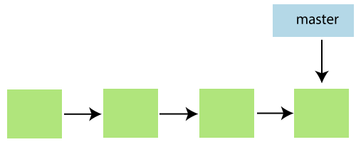
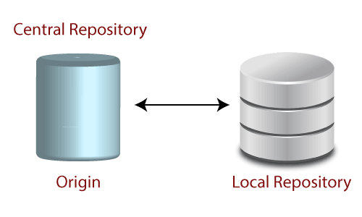

Slide 27
Git Origin
In Git, The term origin is referred to the remote repository where you want to publish your commits.
The default remote repository is called origin, although you can work with several remotes having a different name at the same time.
It is said as an alias of the system.
The origin is a short name for the remote repository that a project was initially being cloned.
It is used in place of the original repository URL. Thus, it makes referencing much easier

Slide 28
In the following example, the URL parameter acts as an origin to the "clone" command for the cloned local repository:
$ git clone https://github.com/ImDwivedi1/Git-Example
Some commands in which the term origin and master are widely used are as follows:
Git push origin master
Git pull origin master
Git has two types of branches called local and remote. To use git pull and git push, you have to tell your local branch that on which branch is going to operate. So, the term origin master is used to deal with a remote repository and master branch.
The term push origin master is used to push the changes to the remote repository. The term pull origin master is used to access the repository from remote to local.

Slide 29
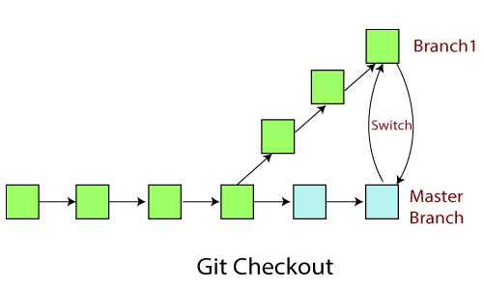
Git Checkout
In Git, the term checkout is used for the act of switching between different versions of a target entity.
The git checkout command is used to switch between branches in a repository.
Be careful with your staged files and commits when switching between branches.

Slide 30
Operations on Git Checkout
We can perform many operations by git checkout command like the switch to a specific branch, create a new branch, checkout a remote branch, and more.
The git branch and git checkout commands can be integrated.

Slide 31
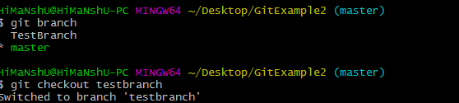
Checkout Branch
To demonstrate available branches in repository, use the below command:
$ git branch
Now, you have the list of available branches. To switch between branches, use the below command.
Syntax: $ git checkout <branchname>

Slide 32


